Slide 1
AVL Tree

Slide 2
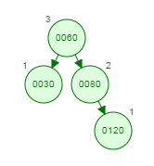
Example 1
Is the following tree is an AVL tree? If not convert in to AVL tree

Slide 3
Insert the nodes 70,125,65,72 and 61 in the above tree, One at time, and show the result of each insertion

Slide 4
Insert 70

Slide 5
Insert 125

Slide 6
Insert 125

Slide 7
Insert 125

Slide 8
Insert 65

Slide 9
Insert 72

Slide 10
Insert 61

Slide 11
Delete 120

Slide 12
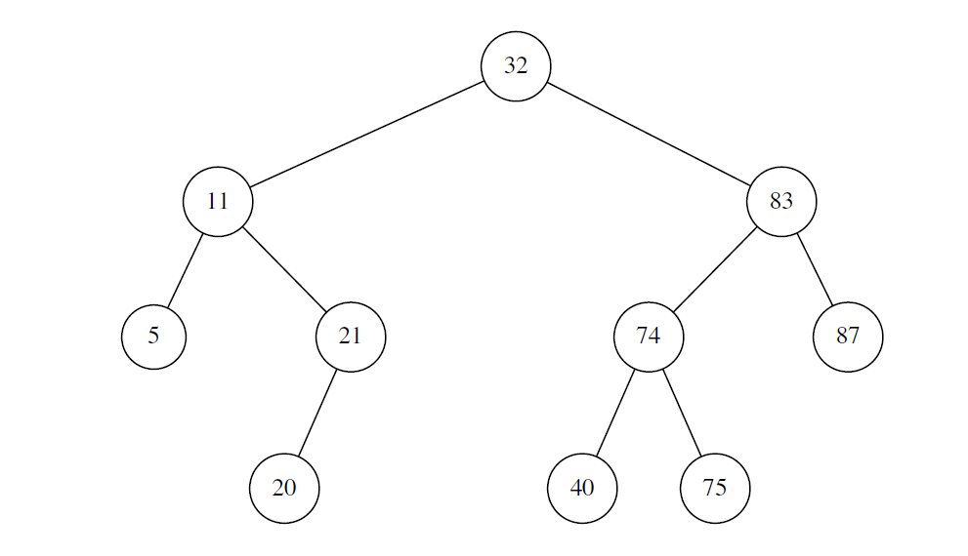
Example 2
Perform the following operations on the AVL tree below: Insert 24,Insert 78,Insert 35,Remove 32,Remove 87. Each operation is independent of the others and must be performed on the original tree. Make sure to mention the rotation performed (none, single, double).

Slide 13
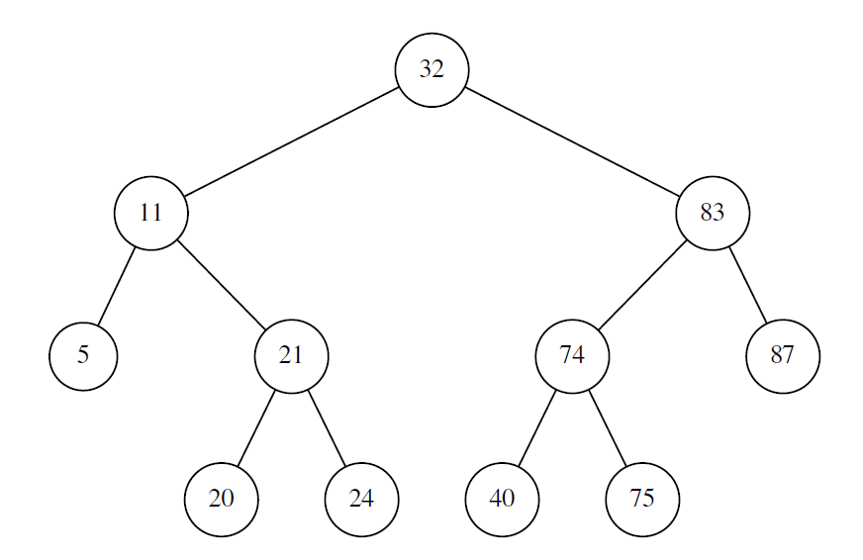
Insert 24

Slide 14
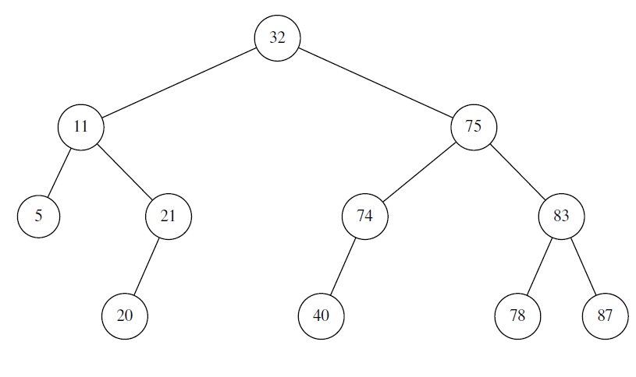
Insert 78
78

Slide 15
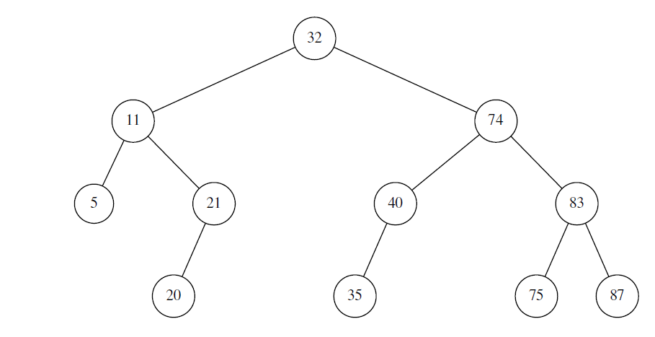
Insert 35
35

Slide 16
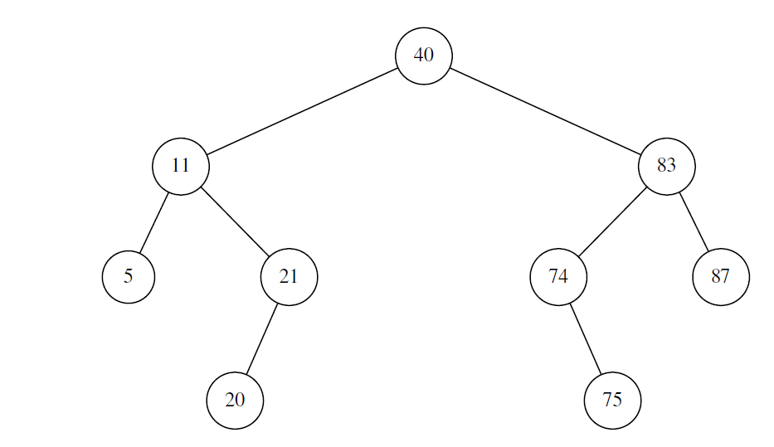
Remove 32

Slide 17
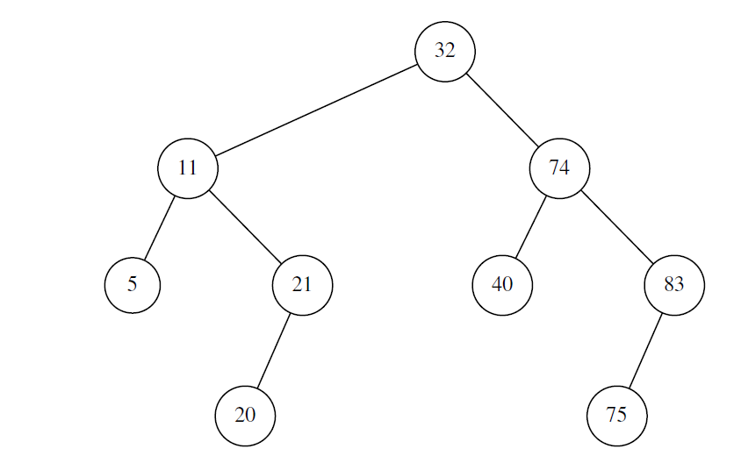
Remove 87

